Slide 1
MY Cars
The Best Platform to Filter Data

Slide 2
What “my cars” actually does
“MY Cars” Filters out the Cars User wants to have from all cars that are for sell in Armenia
It Uses Imputs to create smaller databases
Once the database is created all other filters work on that database
When there are no more filters user wants to import, it either prints or exports the final data!

Slide 3

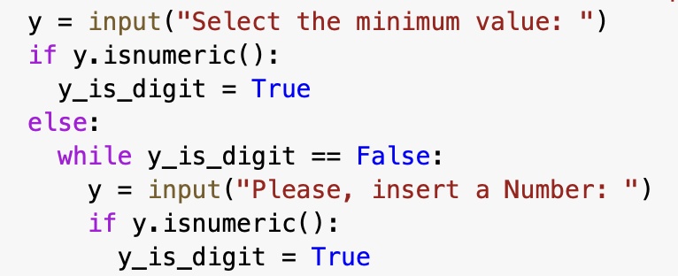
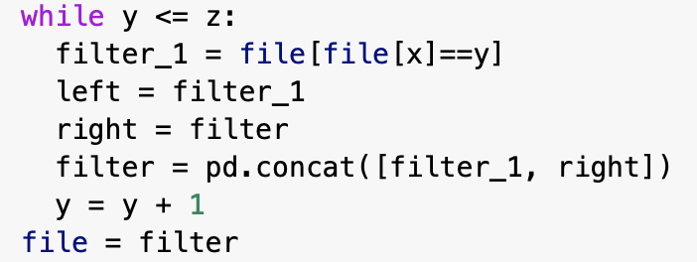

If the filter is numeric
It asks for two values the minimum and the maximum
Afterwards, it creates datas for every value from the minimum to the maximum
To create a final data it simply combines all those dataframes

Slide 4
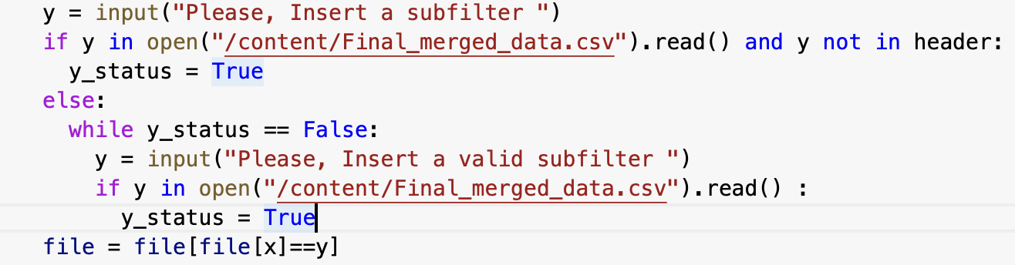
If the filter is a “word”
The code filters out the rows of the specified column which contain the the inserted word!
After it creates a new data with those values
All other filterations are going to be on the new-created database.

Slide 5
That’s it

